Slide 1

Blockchain Governance Module
30.05. – 01.06.2024
Primavera de Filippi, Tara Merk, Felix Beer & Lovisa Björna

Slide 2
Welcome!
Kick-Off Meeting

Slide 3
Agenda
Meet the faculty
What is this about?
Why does it matter?
Educational goals
Module overview
Module logistics
Q&A

Slide 4
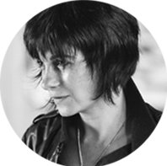
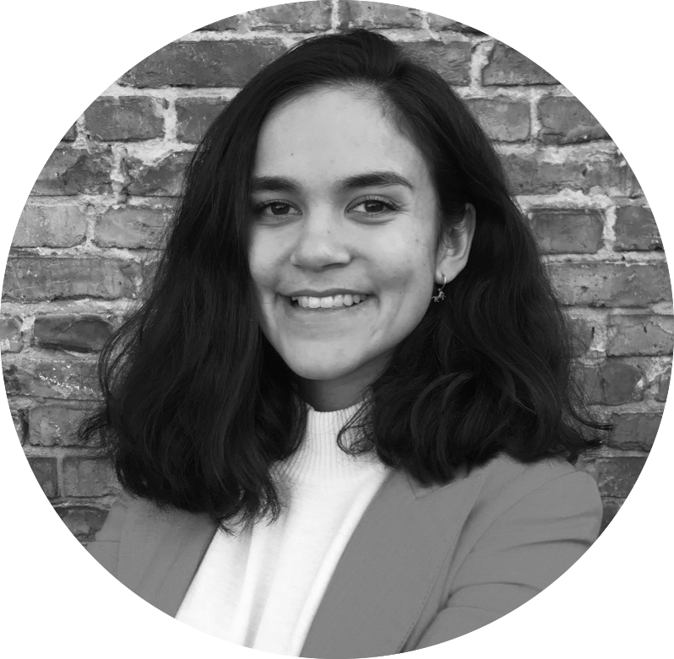






Meet the faculty
Primavera de Filippi
Tara Merk
Lovisa Björna
Felix Beer

Slide 5
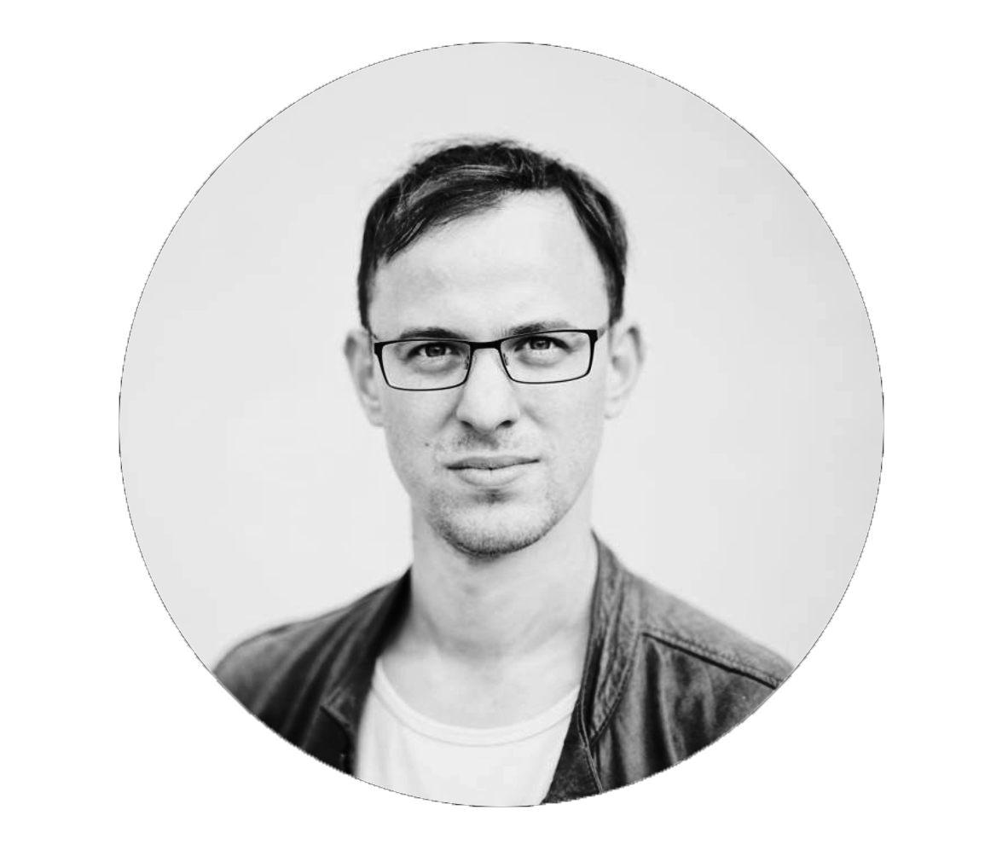

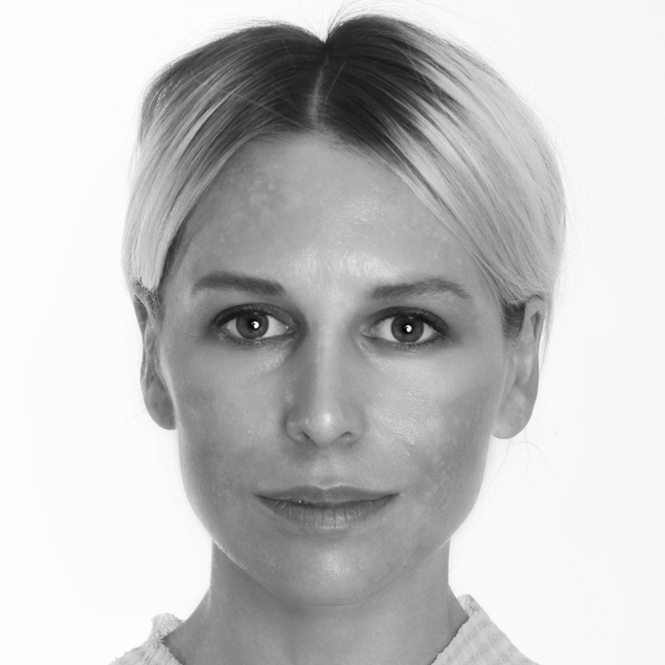

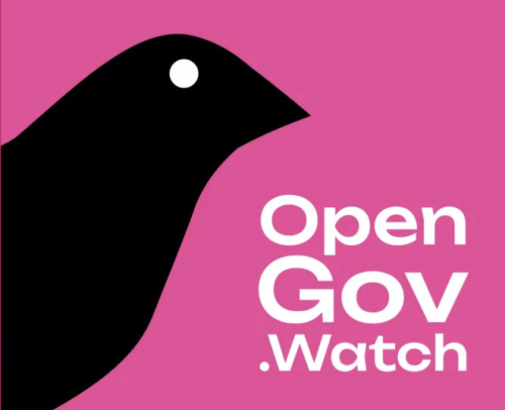

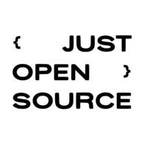

Guest lecturers
Tommi Enenkel
OpenGov.Watch
Nathalie Boyke
Web3 Foundation
Kate Beecroft
Centrifuge
Raul Romanutti
JUST Open Source Foundation

Slide 6
Blockchain Governance

Slide 7

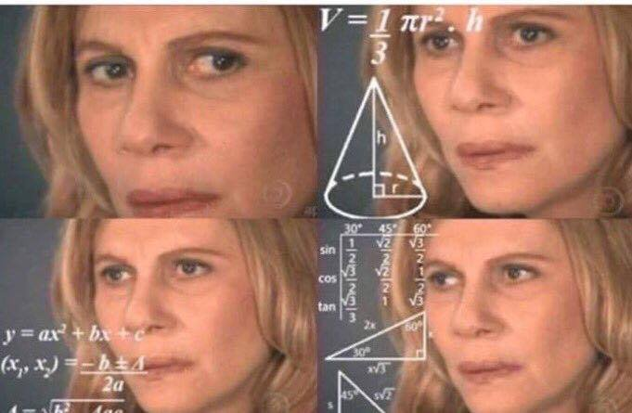
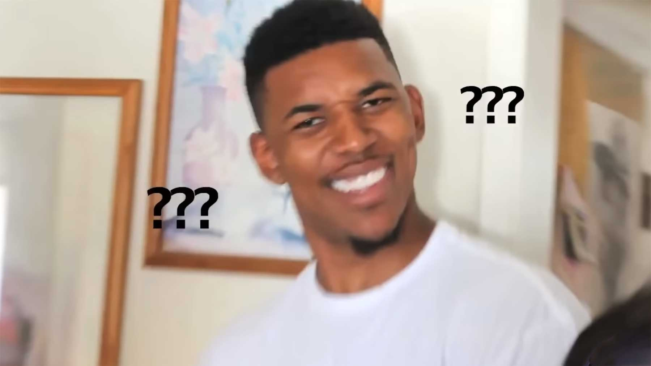
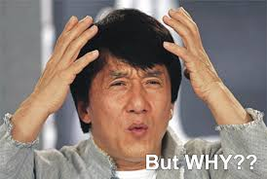
What the **** is blockchain governance?

Slide 8
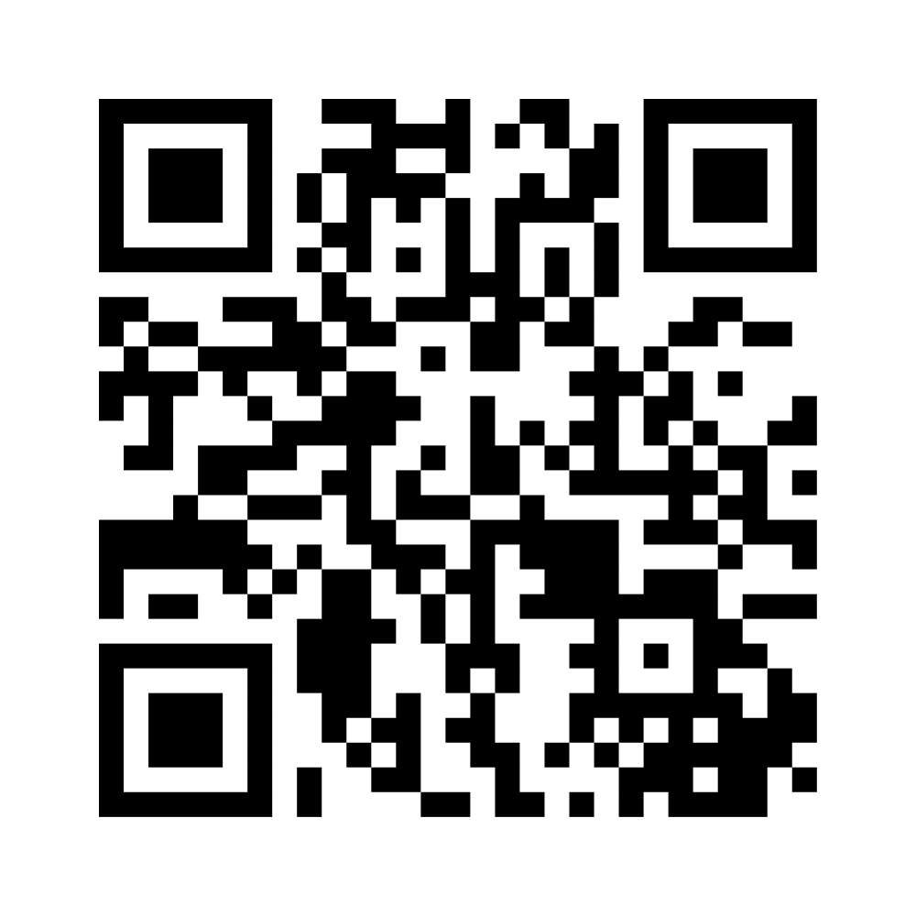
What is blockchain governance?
Describe what concepts, ideas, and topics you associate with this term.
Share your insights on www.menti.com
Access code: XYZ
Scan this QR code:

Slide 9
Blockchain governance is …
A term associated with many topics, meanings, and interpretations;
A concept characterised by a lack of a commonly recognised definition;
A nascent yet rapidly evolving field of research and practice;
An interdisciplinary discourse including computer science, law, political science, sociology, policy and cybernetics.
Notes:
Blockchain governance is many things to many people
Governance is an universal feature of all blockchains, whether explicitly designed or not.
While governance systems vary in their effectiveness, governance itself is a descriptive, rather than a normative, attribute (Yeung & Galindo, 2019). Thus, blockchain networks can be thought of as competing or complementary decision making systems, where choices are proposed, made and implemented in different ways (Alston, 2019).

Slide 10
What is this about?

Slide 11
What is governance?
“Governance describes the norms, structures, and processes by which individuals and groups with ongoing relationships bargain about how to make decisions within an organisational formation — such as a community, market or government” (Bevir, 2012).
Bevir, M. (2012). Governance: A Very Short Introduction. Hampshire, UK: Oxford University Press.
Notes:
The true context of Governance has always been in the act of governing and being governed – more importantly in the act of entrusting a few individuals to create laws, set order and define conduct for the remaining masses. Each form of Government has been founded, structured, pillared and built strong on the concoction of laws and their enforcement.
Good vs bad governance
Even though gaps may appear to be visible in formal texts globally, the Indian backdrop, with its ancient scriptures, texts and other historical proofs has awe-strikingly evidenced the presence of governance since the inception of mankind. Be it the culture of kingship, dictatorship or democracy – irrespective of the form, theory or structure in place;
governance, or even further, the presence of good or bad governance has been a key deciding factor responsible in the rise and downfall of entire civilizations – changing and shaping the course of mankind through the entire timeline.

Slide 12
Governance shapes
political systems

Slide 13
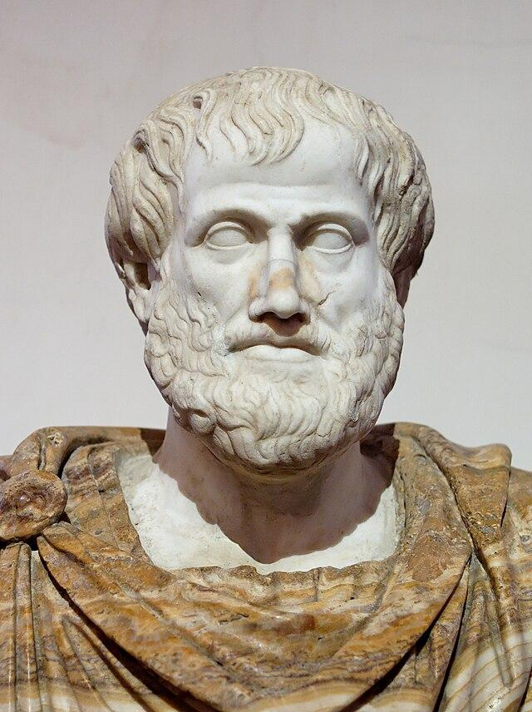
Ancient forms of government
 | Ideal / Common Interest | Despotic / Selfish Interest
One Ruler | Monarchy | Tyranny
Few Rulers | Aristocracy | Oligarchy
Many Rulers | Democracy | Mobocracy
Aristotle
384 - 322 BC
Aristotle (350 BC). Nicomachean Ethics. Hampshire, UK: Oxford University Press.

Slide 14
Governance underpins
all forms of
societal organization

Slide 15
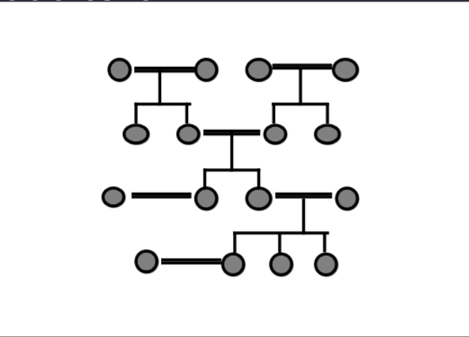
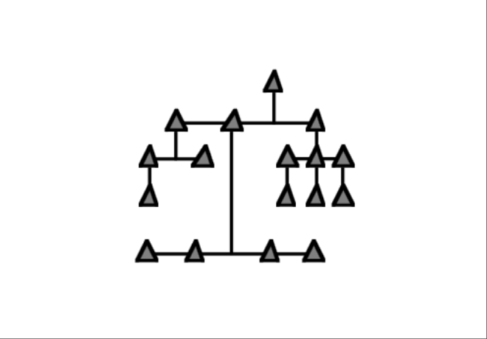
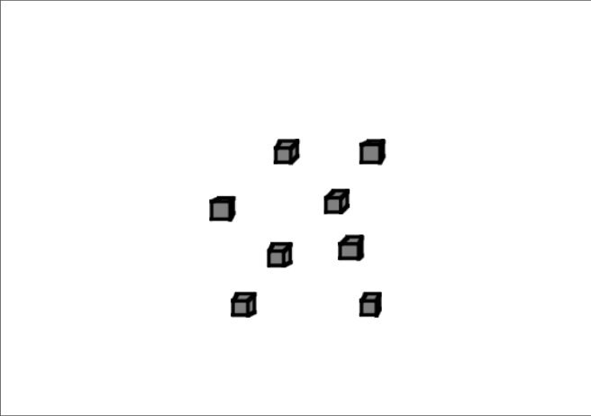
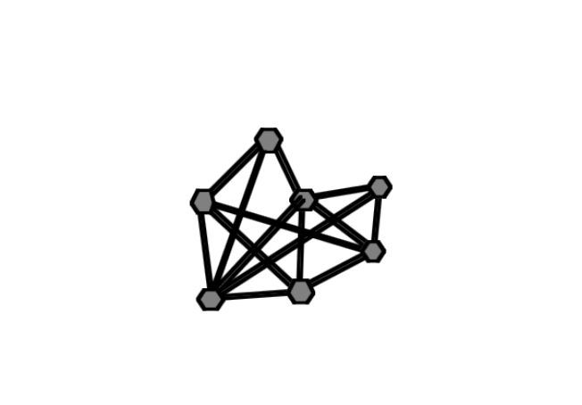
The historical evolution of governance
Ronfelt, D. (1996). Tribes, Institutions, Markets, Networks: A Framework about Societal Evolution. Santa Monica, US: RAND Cooperation.
Tribes
Institutions
Markets
Networks
History
Ronfelt, D. (1996). Tribes, Institutions, Markets, Networks: A Framework for Societal Evolution. Santa Monica, CA: RAND Cooperation.
Notes:
Forms Underlying the Organization of Societies
Ideal typical forms of governance
The idea I've pursued for TIMN is that the rise of each major form — tribes, hierarchical institutions, markets, info-age networks — is associated with a different information and communications technology revolution

Slide 16
Governance differs in
degrees of
power distribution

Slide 17
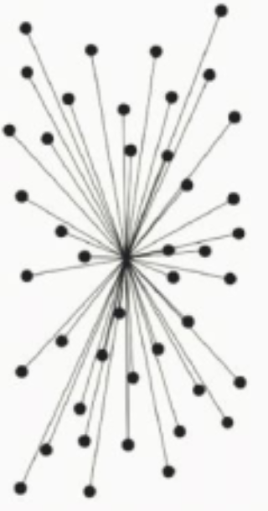
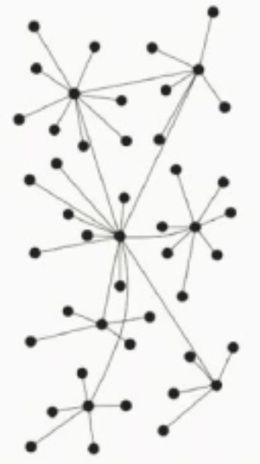
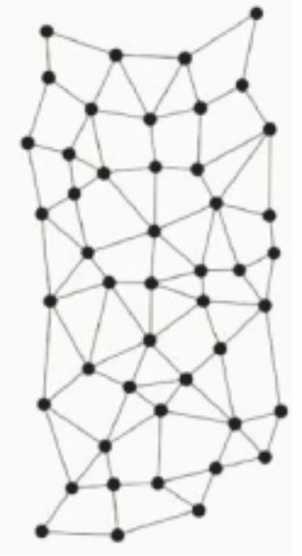
Decentralization is a spectrum, not a label
Centralized
Decentralized
Distributed
Degrees of Power Distribution
Bodo, B., Brekke, J., & Hoepman, J. (2021). Decentralization: A Multidisciplinary Perspective. Internet Policy Review, 10(2).
Notes:
Peter Baran Network Typology (1964): One widely referenced classification of network topologies distinguishes between centralised, decentralised, and distributed networks (Baran, 1964).
In this schematic, centralised describes a network with one central node (for example a server), or a cluster of tightly connected nodes, that is connected to all other nodes in the network (clients), while all these other nodes are only connected to this single central node. As a consequence, the failure or destruction of the central node disconnects all nodes from the network, and prevents them from communicating with each other.
In a decentralised network, there is a hierarchy of nodes, where nodes at the bottom of the hierarchy essentially are part of a small star network that connects them with a node one level higher in the hierarchy. These nodes are again part of another star network connecting them to the next higher-level node in the hierarchy. Failure of a few nodes in a decentralised network still leaves several connected components of nodes that will be able to communicate with each other (but not with nodes in a different component).
At the other end of the spectrum, distributed networks are networks where every node has roughly the same number of connections (called edges) to other nodes. Distributed networks have the property whereby failure of a few nodes (even if they are chosen more or less on purpose) still leaves the network connected, allowing all nodes to communicate with each other (albeit over a possibly much longer path than in the original network)

Slide 18
Governance evolves
alongside technology

Slide 19
Technical shifts 🔁 governance shifts
Age | Ancient | Classical | Medieval | Modern | Information
Period | 10000 - 1000 BC | 1000 BC - 500 AD | 500 - 1500 AD | 1500 - 2000 AD | Since 2000 AD
Technical Innovation | Irrigation, Agriculture, Writing, Money | Alphabet, Naval Trade | 3-Crop Farming, Paper & Printing | Printing Press, Mechanized Labour | Computers, Internet, Blockchains
Political Innovation | River Valley Empires | Roman Empire | Kingdoms & Catholic Church | Nation States | ???
Notes:
Differing degrees of decentralization and centralization

Slide 20
Why does it matter?

Slide 21
Blockchain networks require governance
Governance is an universal feature of all blockchains, whether explicitly designed or not;
Blockchain networks can be thought of as decentralised decision making systems;
Effective governance is crucial for aligning and coordinating diverse stakeholders in a blockchain ecosystem;
Without governance leadership, blockchain networks struggle to succeed.
Notes:
While governance systems vary in their effectiveness, governance itself is a descriptive, rather than a normative, attribute (Yeung & Galindo, 2019).
Thus, blockchain networks can be thought of as competing or complementary decision making systems, where choices are proposed, made and implemented in different ways (Alston, 2019).

Slide 22
A preliminary definition
“Blockchain Governance describes the means of achieving the direction, control and coordination of stakeholders within the context of a given blockchain network to which they jointly contribute” – (van Pelt, Jansen, Baars & Overbeek, 2021)
Notes:
While governance systems vary in their effectiveness, governance itself is a descriptive, rather than a normative, attribute (Yeung & Galindo, 2019).
Thus, blockchain networks can be thought of as competing or complementary decision making systems, where choices are proposed, made and implemented in different ways (Alston, 2019).

Slide 23
Why should you care?

Slide 24
How do you rate your expertise?
Rate your blockchain governance expertise on a scale from 0 (none) to 3 (expert).
Share your insights on www.menti.com
Access code: XYZ
Scan this QR code:

Slide 25
Become a governance expert!
Governance is often poorly understood yet highly relevant for the success of a blockchain project;
There is a noticeable lack of technologists trained in blockchain governance;
Polkadot is a highly decentralized governance system;
Your governance expertise is a critical asset for your project’s long-term impact and viability.
Notes:
While governance systems vary in their effectiveness, governance itself is a descriptive, rather than a normative, attribute (Yeung & Galindo, 2019).
Thus, blockchain networks can be thought of as competing or complementary decision making systems, where choices are proposed, made and implemented in different ways (Alston, 2019).

Slide 26
Our educational goal

Slide 27
Promote governance literacy
Equip blockchain technologists with the necessary competences to design and implement effective governance, both on-chain and off-chain.
Contribute to the professionalization of blockchain governance as a recognised field of expertise.
Notes:
While governance systems vary in their effectiveness, governance itself is a descriptive, rather than a normative, attribute (Yeung & Galindo, 2019).
Thus, blockchain networks can be thought of as competing or complementary decision making systems, where choices are proposed, made and implemented in different ways (Alston, 2019).

Slide 28
Learning outcomes
Understand the key governance principles, mechanisms and trade-offs;
Develop a strategy for progressive decentralization;
Design and implement effective governance innovations;
Navigate their political, regulatory and ethical implications;
Measure and improve the impact of governance systems.

Slide 29
Q & A

Slide 30
Module overview

Slide 31
TIME | DAY 1 | DAY 2 | DAY 3
09AM | Kick-Off Presentation | Assignment Review & Sharing Circle | Integration & Learning Circle (Felix & Lovisa)
10AM | Lecture 1: “Blockchain Governance in Theory & Practice” (Primavera) | Presentation of Governance Challenges (Challenge Providers) | Integration & Learning Circle (Felix & Lovisa)
11AM | Lecture 1: “Blockchain Governance in Theory & Practice” (Primavera) | Group Work on Challenges | Fish Bowl “The Future of Governance” (Primavera, Tara, Lovisa, Felix, Nathalie, Tommi)
12AM | Lecture 1: “Blockchain Governance in Theory & Practice” (Primavera) | Group Work on Challenges | Wrap-Up & Feedback Form
01PM | Lunchbreak | Lunchbreak | Lunchbreak
02PM | Lecture 2: “Blockchain Governance Design” (Tara & Felix) | Group Work on Challenges
03PM | Lecture 2: “Blockchain Governance Design” (Tara & Felix) | Group Work on Challenges
04PM | Lecture 3: “OpenGov Introduction” (Tommi) | Challenge Presentation & Feedback
05PM | Wrap-Up, Assignment + Q&A | Challenge Presentation & Feedback
06PM | Office Hour | Office Hour

Slide 32
Assignments
Take Home Assignment (DAY 1)
To be completed by beginning of DAY 2;
To be presented in class to peers;
Please a review course material from DAY 1 for completion.
Governance Challenge (DAY 2)
To be completed by end of DAY 2;
To be presented in class to faculty and peers;
Please review your governance challenge briefing and reading recommendations before DAY 2.

Slide 33
Module logistics

Slide 34
Online & on-site participation
Online Students:
All course materials available in our Discord channel.
Ask questions throughout in our chatroom and we will see to them at the end of each class.
Any Q’s - write to Remote TA or Lovisa.
On-Site Students:
All course materials are in the symposium that you have received.
Also available in our Discord channel.
Office Hours from 5-6PM.
Any Q’s - talk to faculty or write to Felix.

Slide 35
Get in touch!
Lovisa Björna
Responsible for Online Students
Email: lovisa@polkadot.academy
Discord: @loppeflopp
Felix Beer
Responsible for On-Site Students
Email: felix@polkadot.academy
Discord: @felixculpa.

Slide 36
Q & A

Slide 37
Thanks & Enjoy!

Slide 38
Blockchain Governance in Theory & Practice
Lecture 1, 30.05.
Primavera de Filippi

Slide 39
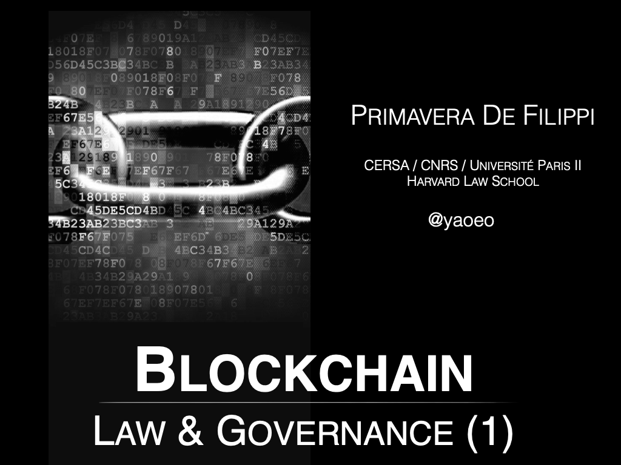


Slide 40
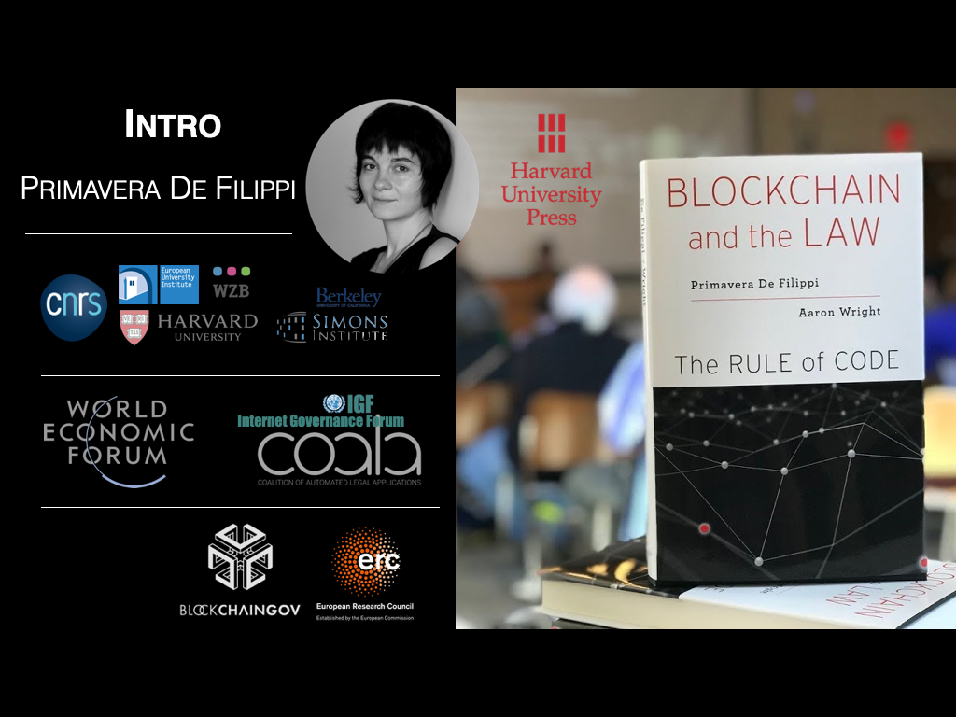

Slide 41
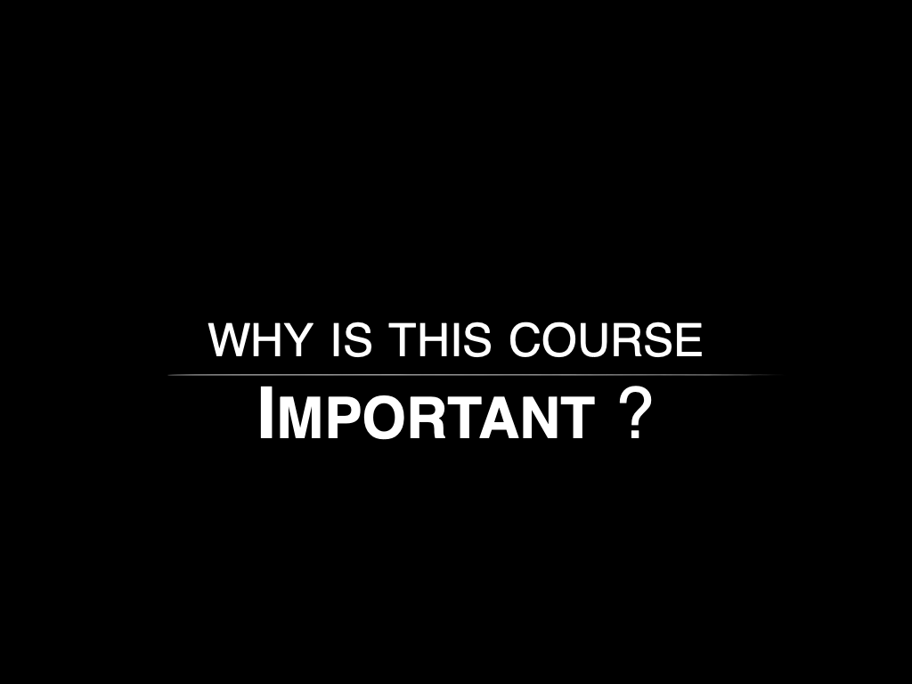

Slide 42
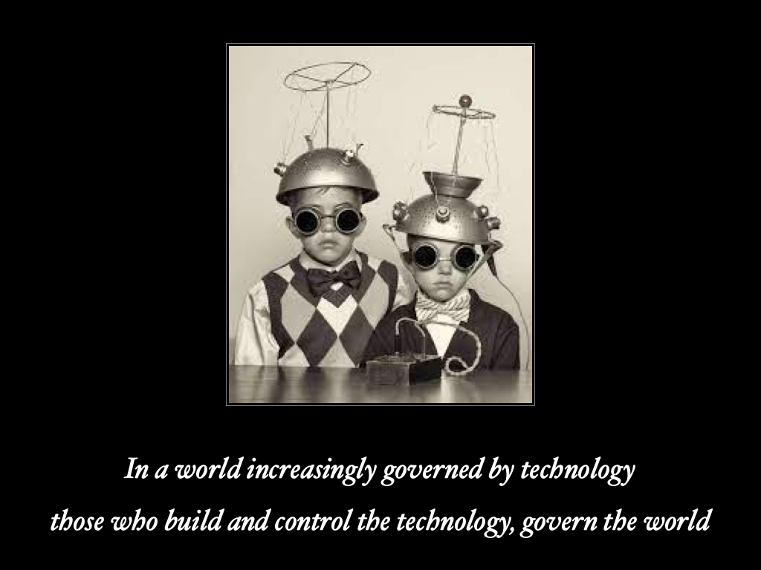

Slide 43
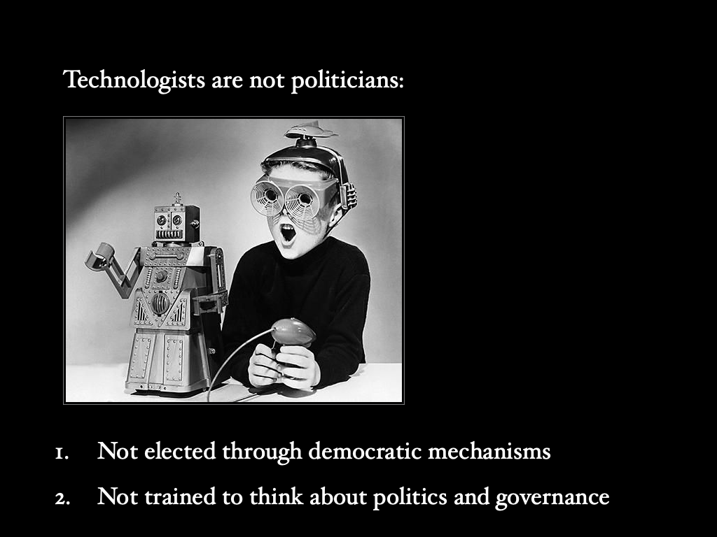

Slide 44
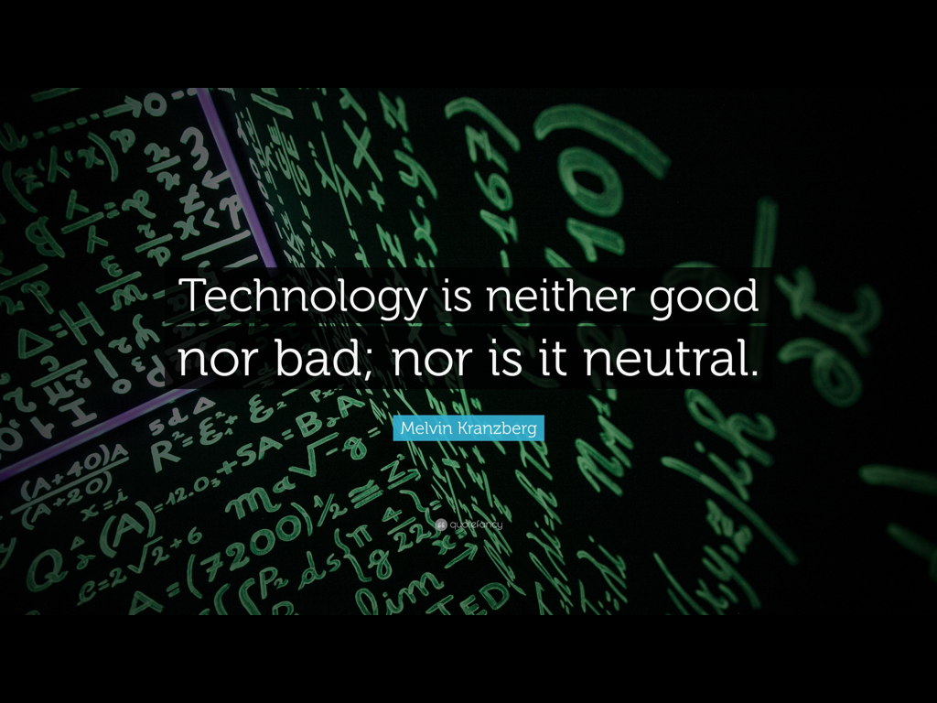

Slide 45
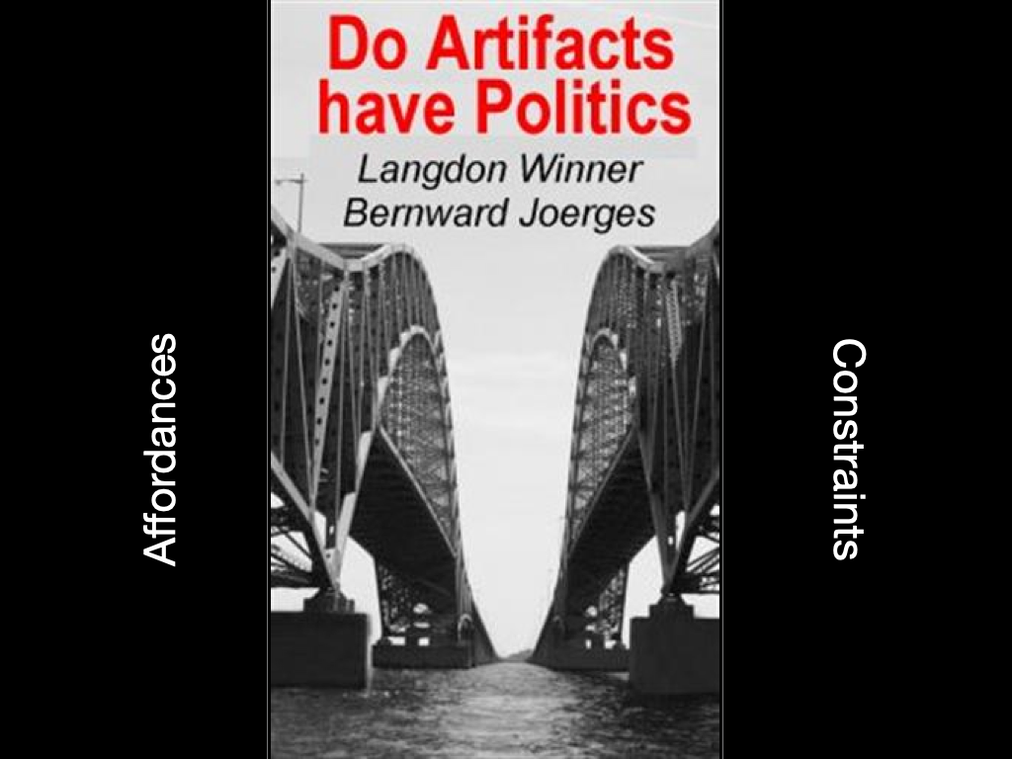

Slide 46
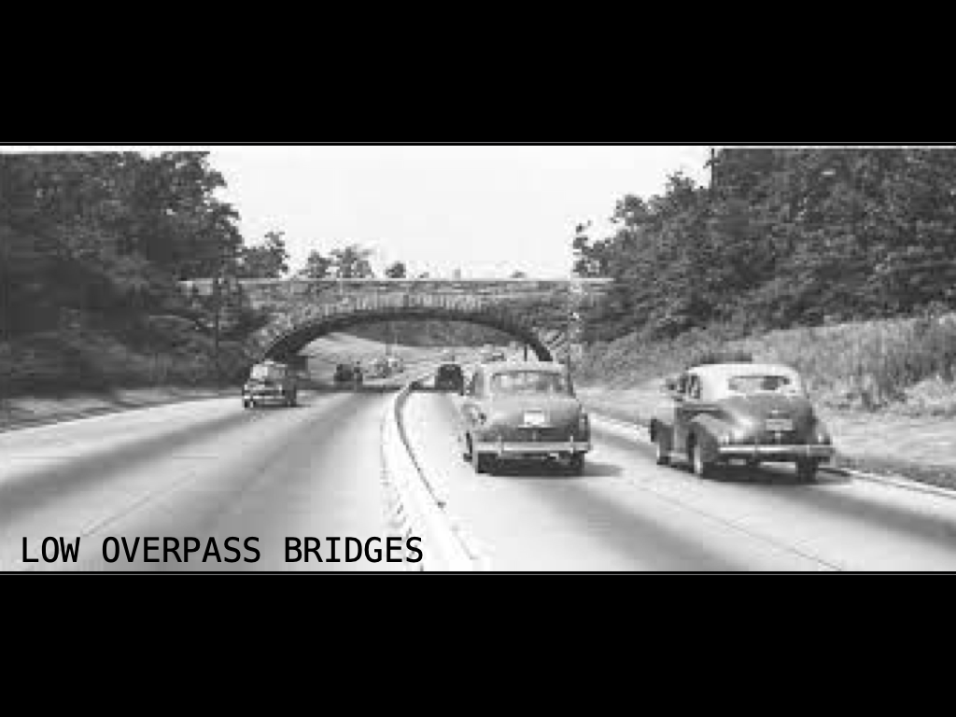

Slide 47


Slide 48
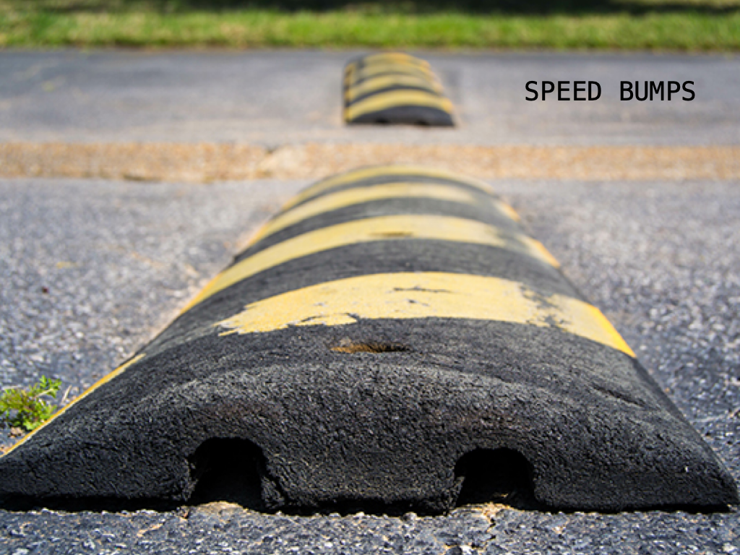

Slide 49
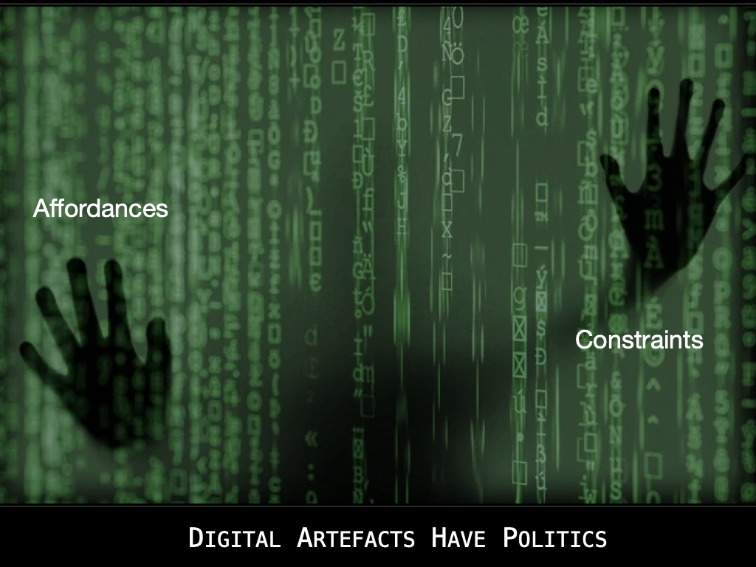

Slide 50
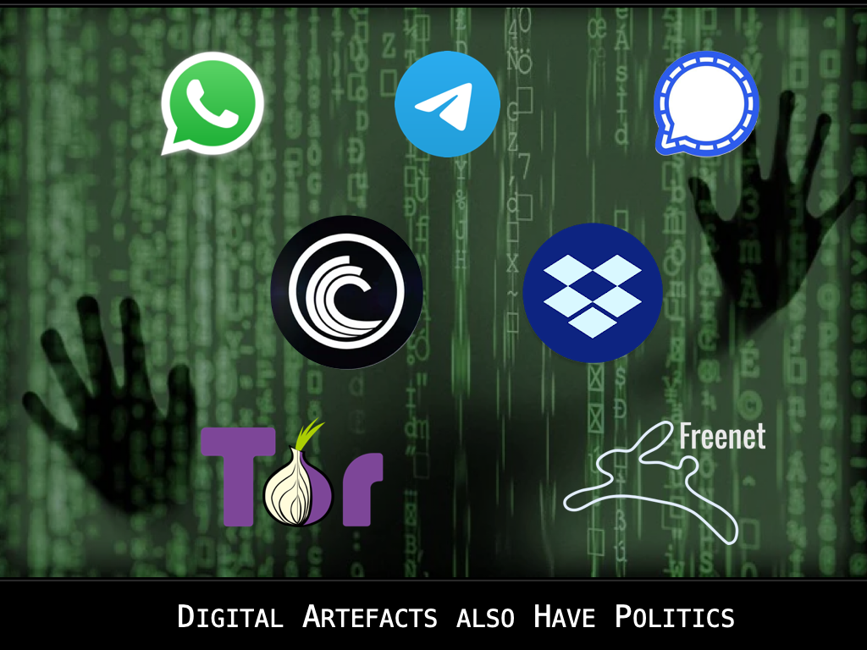

Slide 51
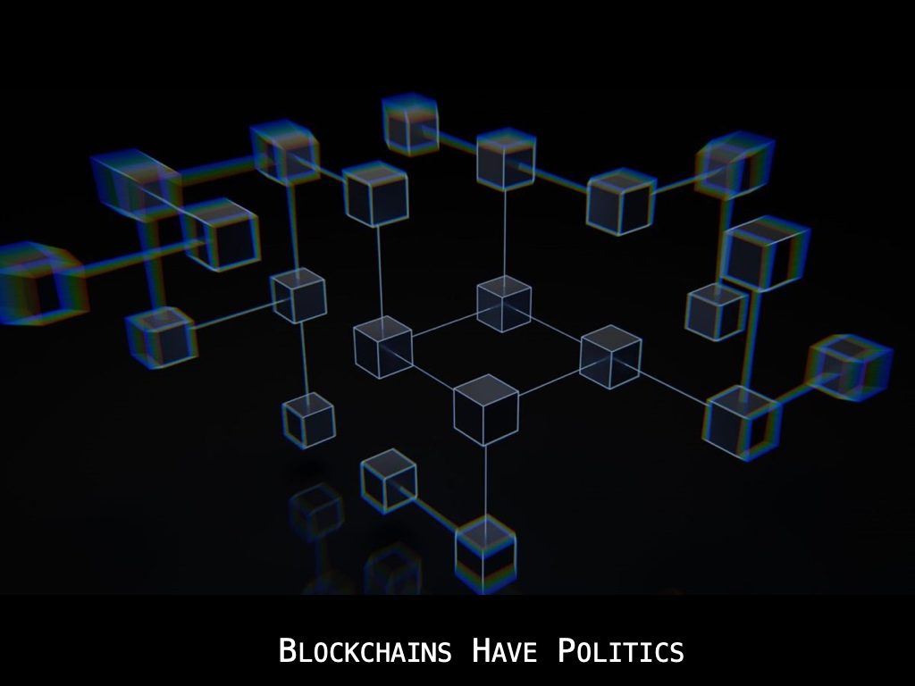

Slide 52
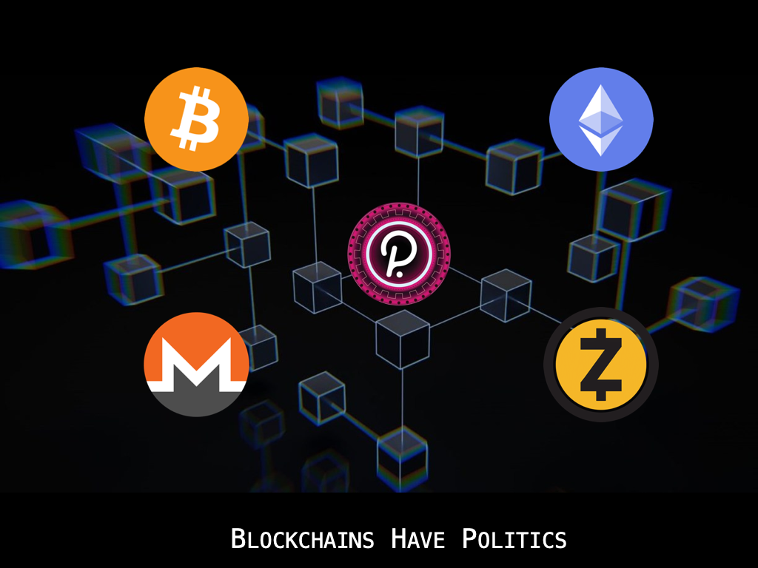

Slide 53
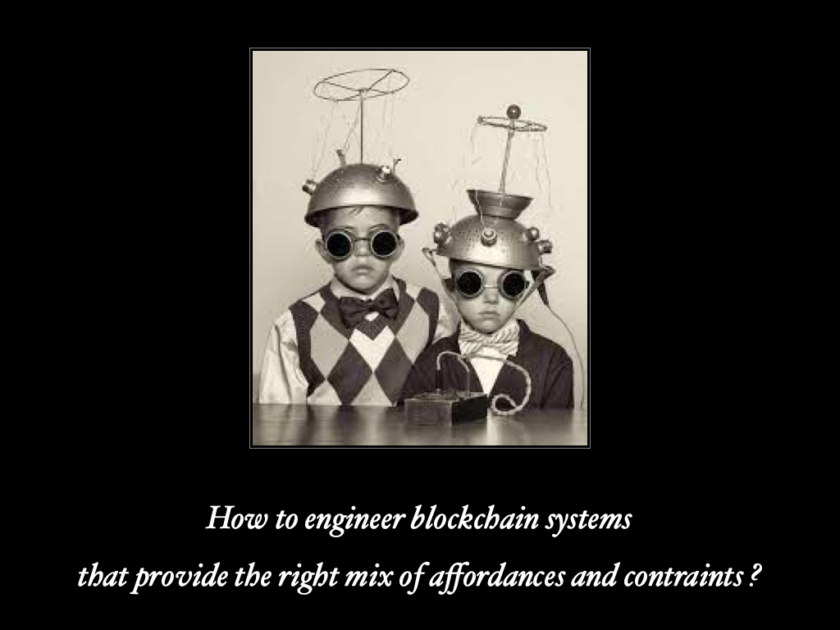

Slide 54
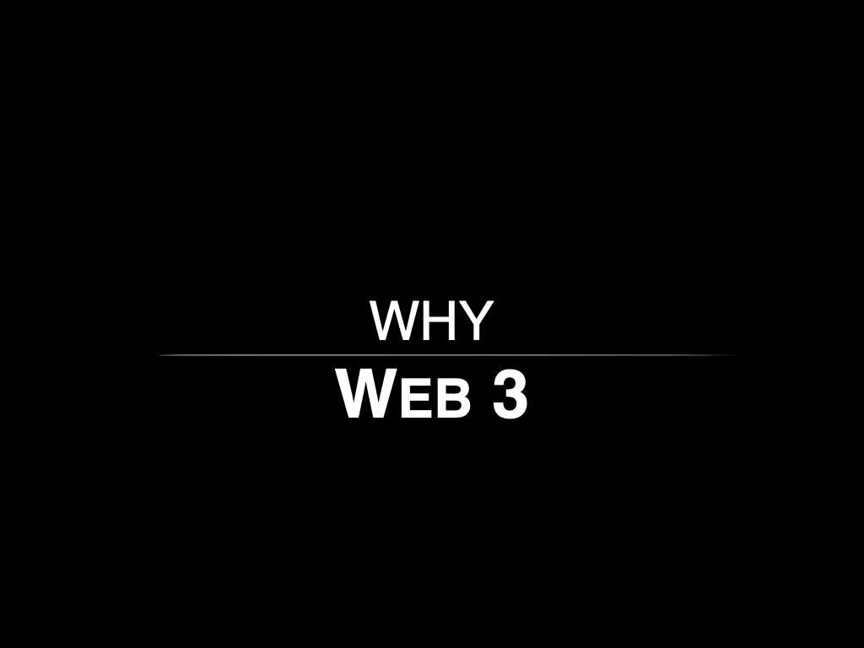

Slide 55
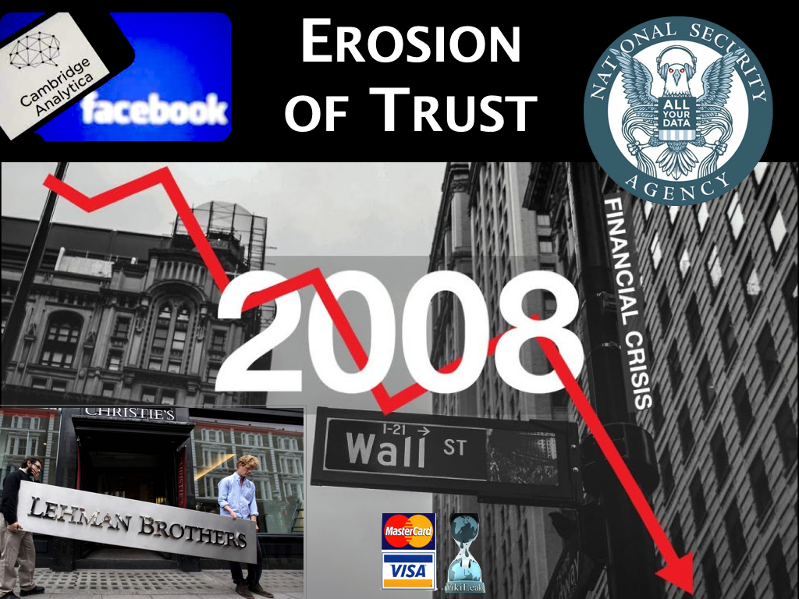

Slide 56
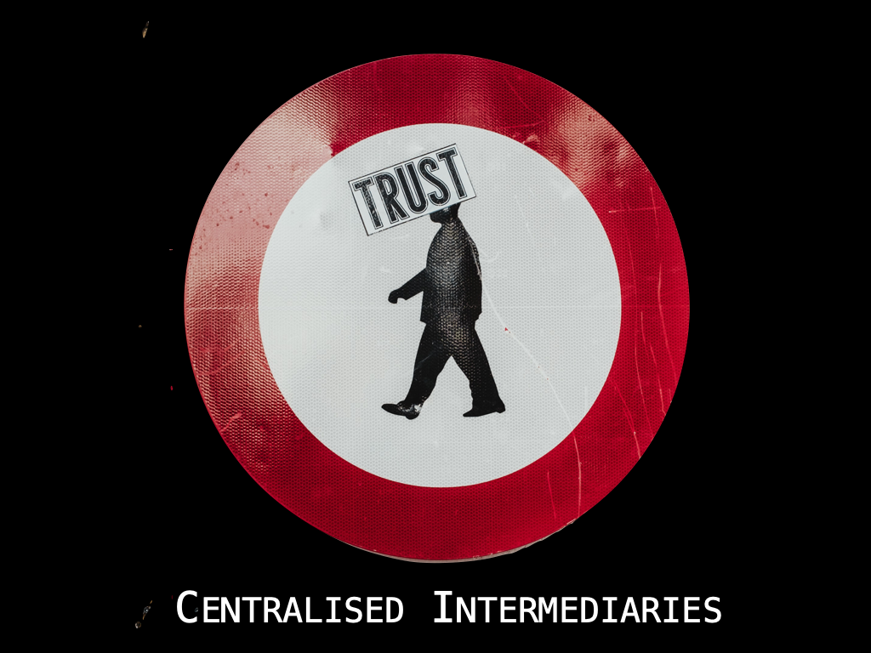

Slide 57
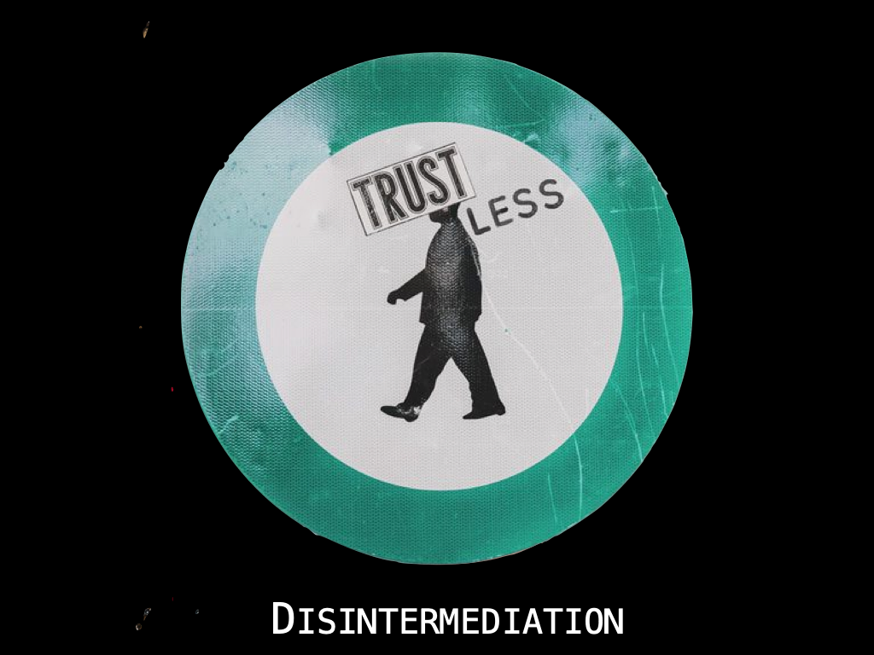

Slide 58
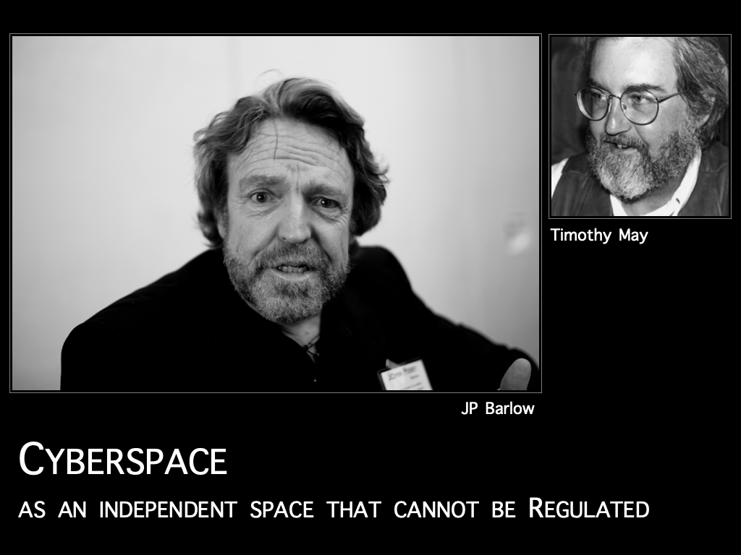

Slide 59
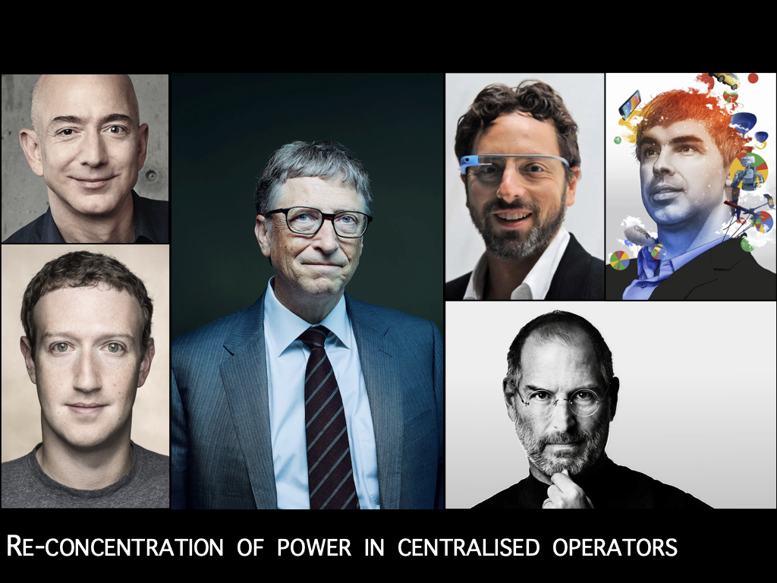

Slide 60
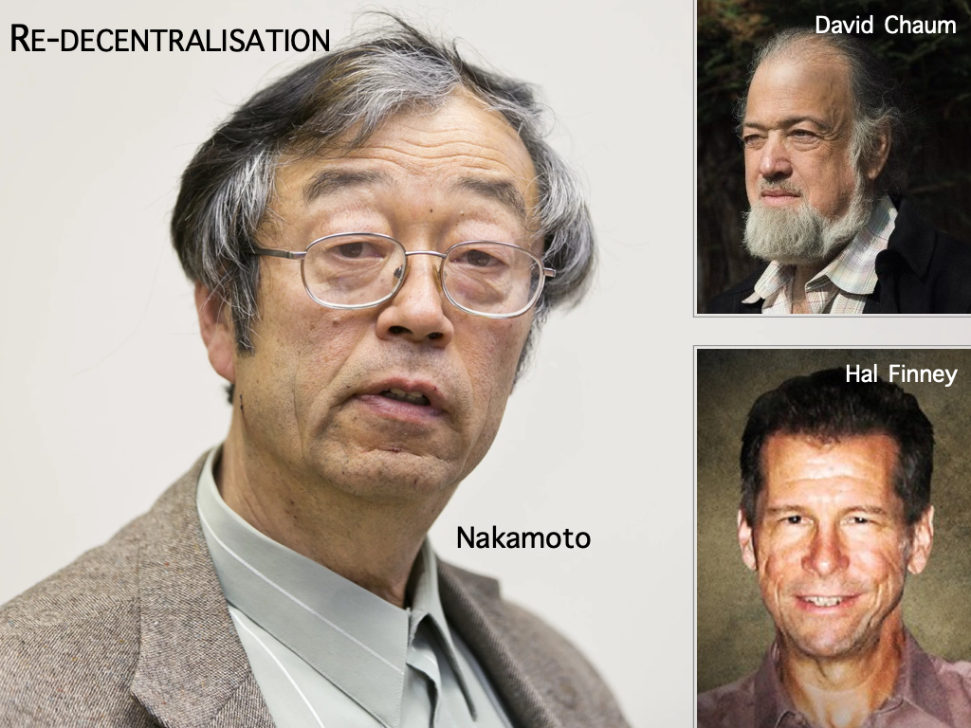

Slide 61
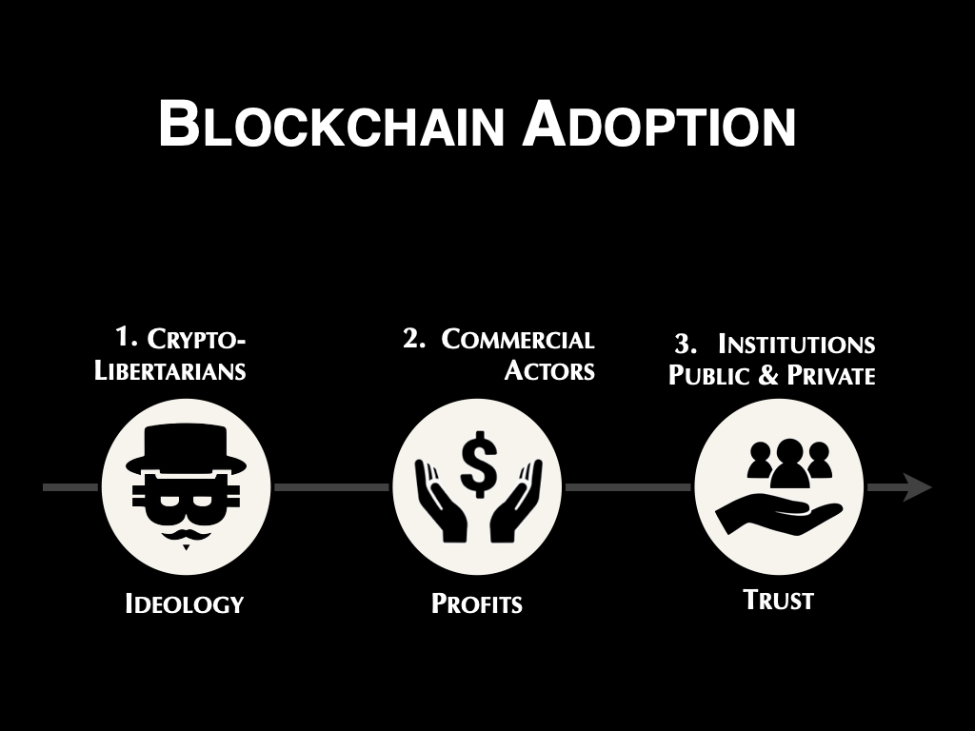

Slide 62
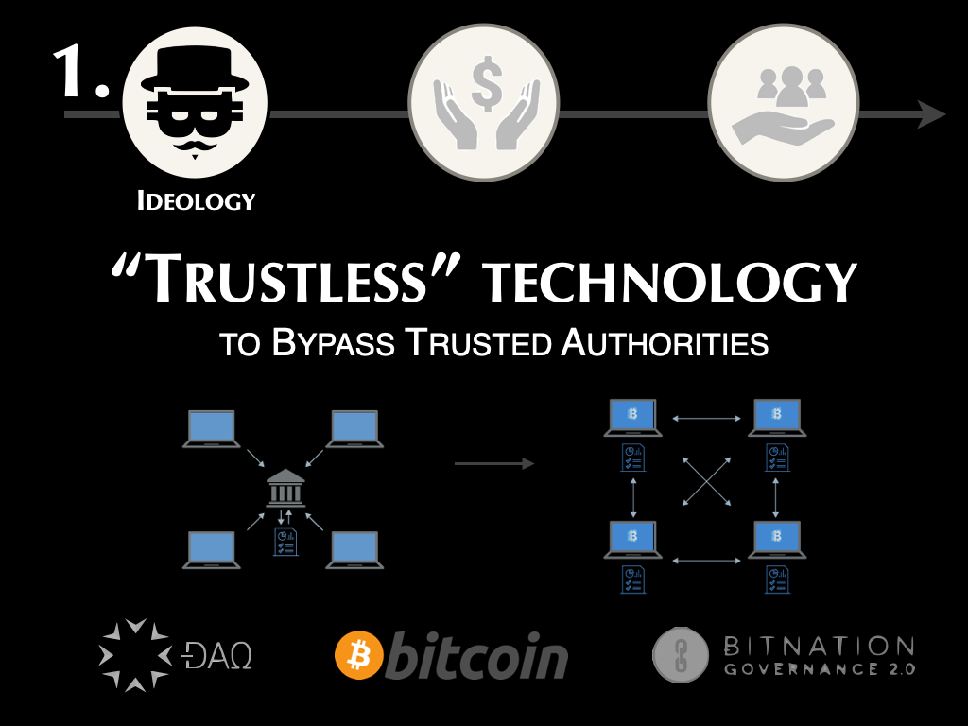

Slide 63
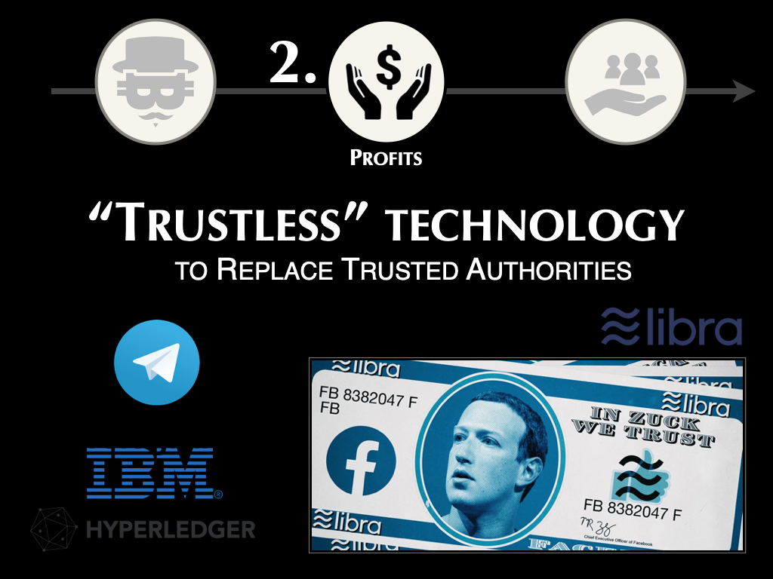

Slide 64
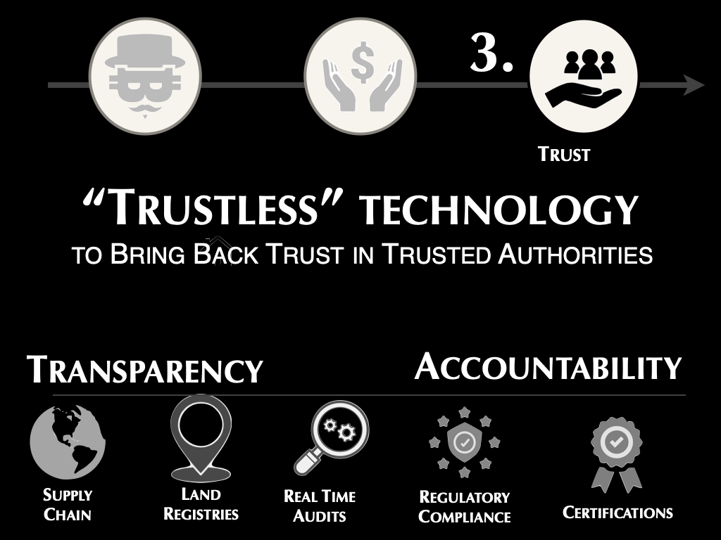

Slide 65
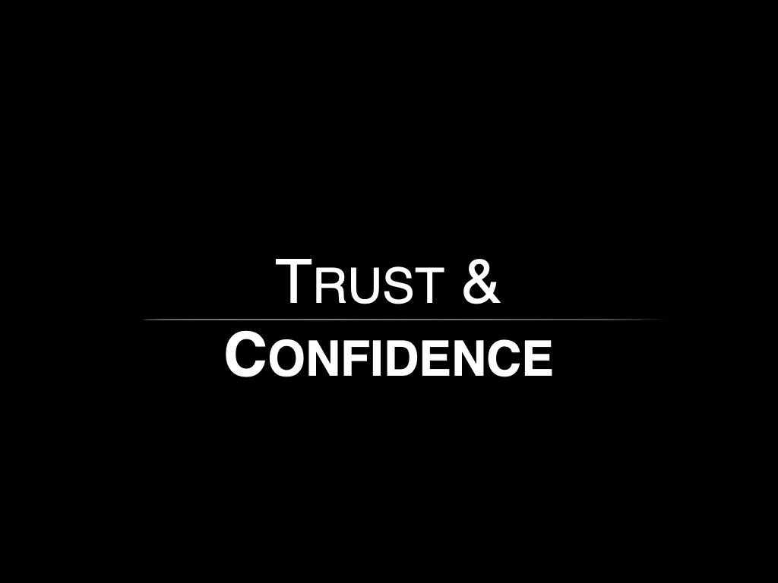

Slide 66
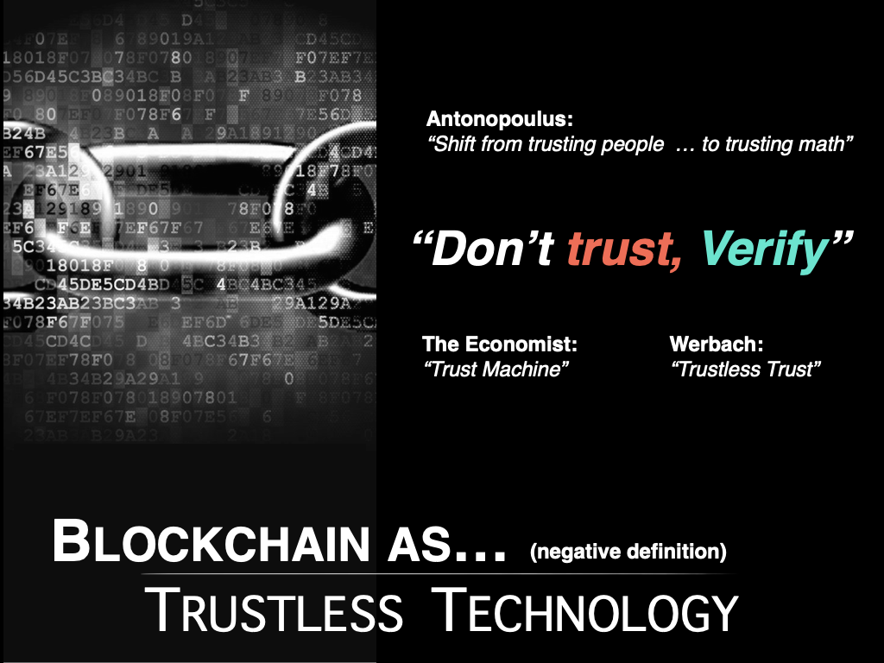

Slide 67
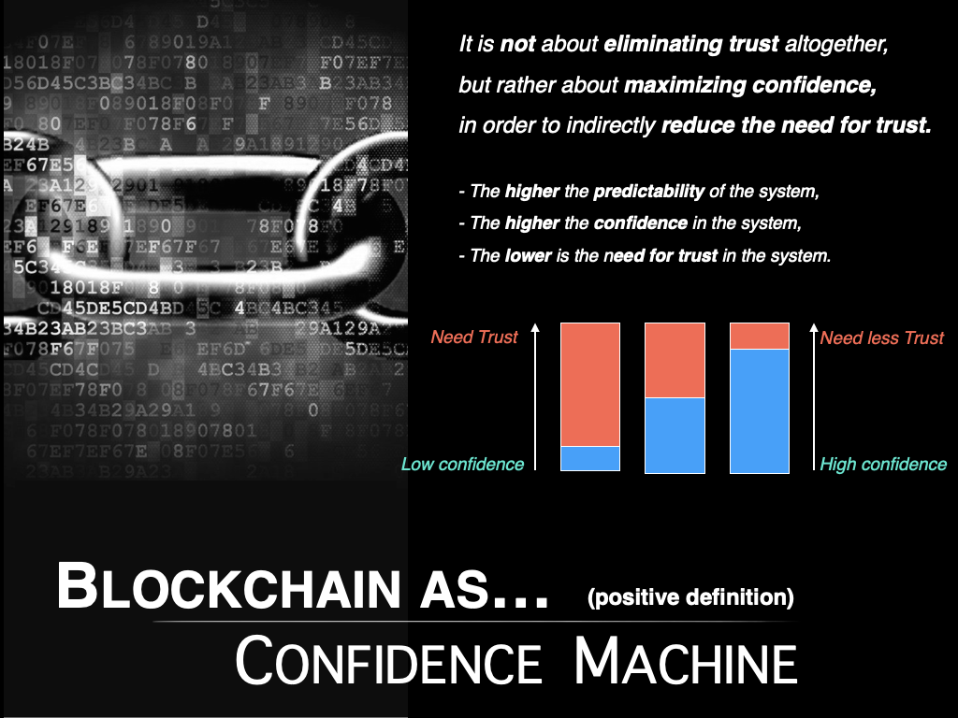

Slide 68
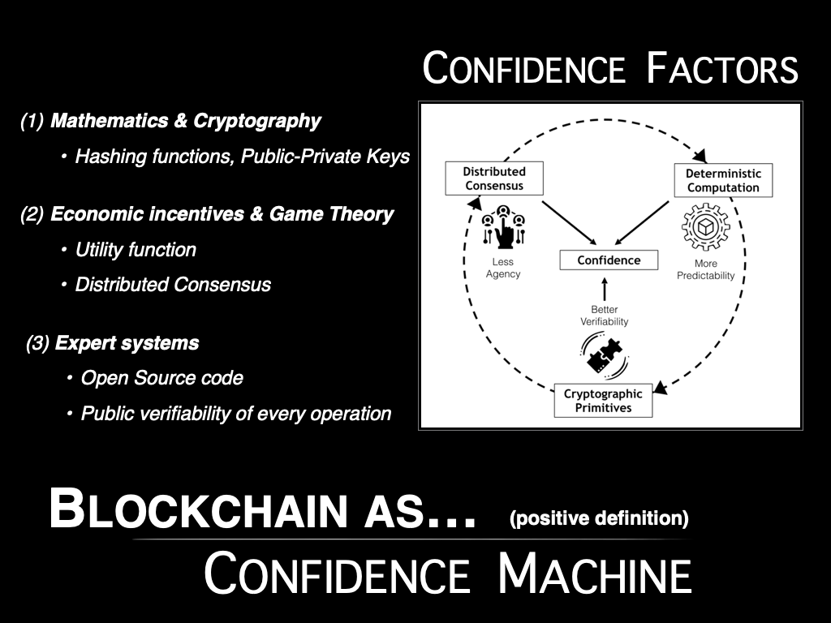

Slide 69
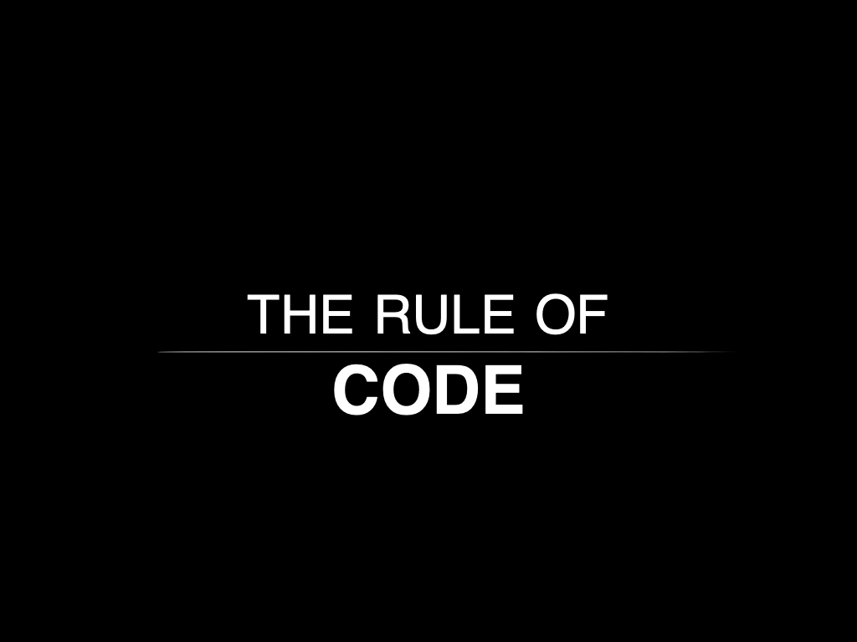

Slide 70
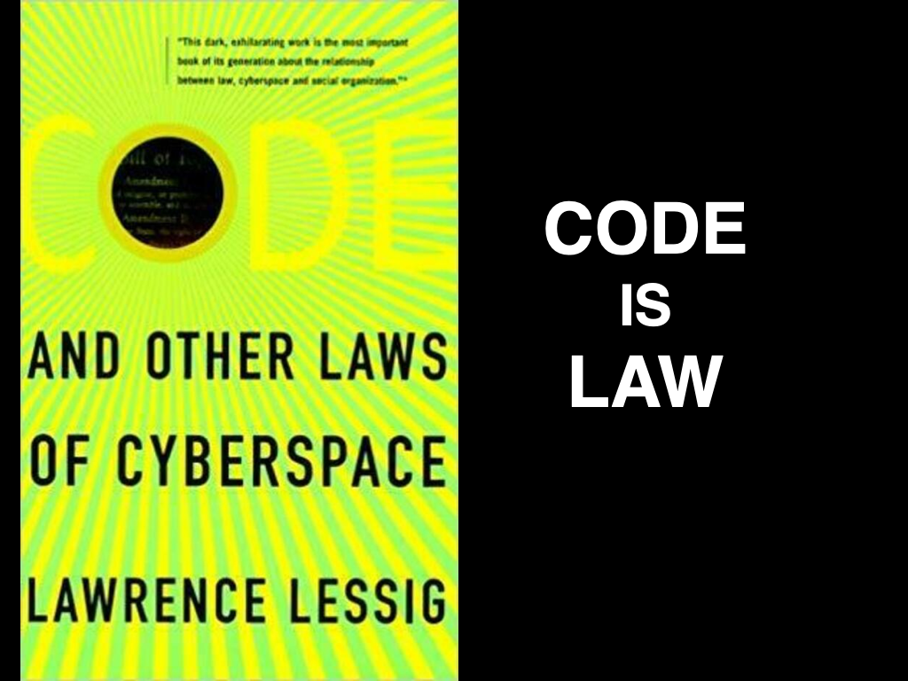

Slide 71
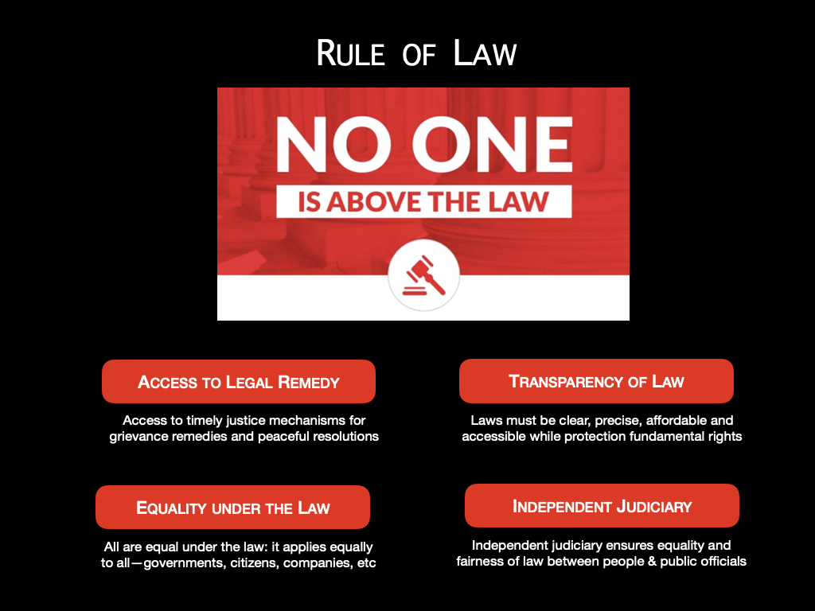

Slide 72


Slide 73


Slide 74


Slide 75


Slide 76


Slide 77


Slide 78


Slide 79


Slide 80


Slide 81


Slide 82


Slide 83


Slide 84


Slide 85


Slide 86


Slide 87


Slide 88


Slide 89


Slide 90


Slide 91


Slide 92


Slide 93


Slide 94


Slide 95


Slide 96


Slide 97


Slide 98


Slide 99


Slide 100


Slide 101


Slide 102


Slide 103


Slide 104


Slide 105


Slide 106
Lunchbreak :)

Slide 107
Designing
Blockchain Governance
Lecture 2, 30.05.
Tara Merk & Felix Beer

Slide 108
Agenda
What is Governance Design?
Governance Lifecycle
Governance Cookbook
Transition Stewardship
Q&A

Slide 109
What is governance design?

Slide 110
Designing in “the wild”
Notes:
Metaphor - "The map is not the territory": Use this metaphor to explain that theoretical frameworks and models in governance design do not fully encapsulate the complexity and dynamics of real-world applications.

Slide 111
Governance design is a nascent field
An emerging and rapidly evolving field of research and practice.
Existing theories and models do not fully capture the complexity of designing governance in reality.
Limited precedents, fast-paced technological advancements, and constantly evolving challenges.
There is no blueprint for
Notes:
Metaphor - "The map is not the territory": Use this metaphor to explain that theoretical frameworks and models in governance design do not fully encapsulate the complexity and dynamics of real-world applications.

Slide 112
There are no one-size-fits-all solutions

Slide 113
Governance design is experimental
There are no silver bullets or one-size-fits-all for effective governance solutions.
The design of governance systems is highly context-specific.
Constant adaptation and refinement is needed to build effective systems.
Governance design requires real-world testing
Notes:
Different scenarios require different governance mechanisms and practices;
Governance mechanisms thus need to be tailored to the specific context of decision-making.
Requires constant adaptation and refinement as new technologies and stakeholder dynamics emerge.
Demands real-world testing and feedback to validate and improve governance frameworks effectively.

Slide 114
Technology is not just for technologists; we need all disciplines involved

Slide 115
Governance design is multidisciplinary
Economics
What are the incentives and interests of stakeholders?
Computer
Science
How to code on-chain mechanisms?
Community
Management
How to engage and represent stakeholders?
Law
How to ensure compliance with existing regulations?
Blockchain
Governance Design
Environmental Studies
What is the environmental impact of a blockchain?
Cybernetics
How to develop and integrate feedback loops?
Political
Science
How to assess and navigate the policy implications of a blockchain?
Sociology
How to understand the impact of blockchains on social systems?
Notes:
Beyond Technology: Explain that governance design integrates insights from law, economics, sociology, and political science, not just technology.
Role of Diverse Expertise: Emphasize how professionals from various disciplines contribute to more robust and comprehensive governance structures.
Collaboration Importance: Highlight examples of successful governance frameworks that resulted from interdisciplinary collaboration.
Solving complex governance challenges depends on diverse disciplines, perspectives, and backgrounds.
multiple stakeholders, disciplines, and perspectives requires an agnostic space for understanding and knowledge-sharing.
Technologists can’t solve complex governance issues alone. Instead, we must incorporate these disciplines and backgrounds to ensure a better understanding of the evolving ways technology impacts us — and the options improving the current situation.

Slide 116
How to get started?
Notes:
Continuous Learning & Process Improvement
Encourages an active pursuit of ongoing learning and the enhancement of the process design for governance mechanisms.
Learning Strategy: Developing strategies for continuous learning to stay updated with the evolving blockchain governance landscape.
Knowledge Sharing: Cultivating a culture of collaboration and knowledge sharing to improve blockchain governance practices.
Adaptive Mindset: Embracing a lifelong learning mindset to drive adaptability in the dynamic blockchain ecosystem.

Slide 117
Seven ways to start your journey
Make governance a priority.
Don’t overthink, get started: There is no right or wrong; only proactive and reactive design.
Get familiar with research and best practices but don’t get lost.
Develop a vision with clear goals and objectives.
Innovate through iterative action-learning cycles.
Design not only for but with the community.
Collaborate with other projects, disciplines and sectors.
Notes:
To overcome this obstacle, it’s best to avoid over-conceptualization, academic jargon, and preaching about responsibility and risk, which can all be intellectually patronizing.
Try to make your project not just interactive but iterative too. Be ready to change the design, course and aims of your project by taking into account the inputs of the engaged publics with specific experiences and knowledges. Discuss these changes with them. And repeat.
These obstacles probably rest on a rather monolithic view of the public. Be aware of the range of constituencies that you are engaging with, their disparate interests, types of knowledges and experiences. Detailed mapping of your stakeholders is crucial, and why not work with social scientists? And remember to make use of your soft skills, personal networks and expertise as a member of society.

Slide 118
The lifecycle perspective
Notes:
Continuous Learning & Process Improvement
Encourages an active pursuit of ongoing learning and the enhancement of the process design for governance mechanisms.
Learning Strategy: Developing strategies for continuous learning to stay updated with the evolving blockchain governance landscape.
Knowledge Sharing: Cultivating a culture of collaboration and knowledge sharing to improve blockchain governance practices.
Adaptive Mindset: Embracing a lifelong learning mindset to drive adaptability in the dynamic blockchain ecosystem.

Slide 119

The governance lifecycle model
A strategic framework for structuring governance innovation in distinct phases.
A lens similar to agile product management.
An iterative approach focused on continuous evaluation and improvement.
Notes:
Mirroring the iterative nature of product development—where ideas are prototyped, tested, and refined based on feedback—the governance design for blockchain networks undergoes continuous enhancement to meet the evolving needs and challenges of decentralized systems.

Slide 120
The six lifecycle stages
Define
Design
Build
Transition
Measure
Upgrade

Slide 121
1. Define the vision
Develop a purpose: Establish clear goals and objectives that governance needs to achieve.
Identify stakeholders: Map out all relevant stakeholders and define their roles and responsibilities.
Establish a design framework: Create the foundational governance primitives, principles, and protocols.
Notes:
You need to be crystal clear on why and how a governance intervention enhances your project.

Slide 122
2. Design the intervention
Draft a strategic roadmap: Develop a step-by-step plan for the design and deployment of the governance intervention.
Allocate resources: Assess essential resources, including personnel and technology, to support the governance implementation.
Handle legal considerations: Identify and navigate regulatory and compliance requirements.

Slide 123
3. Build the right mechanism
Prototype and test mechanisms: Iterate mechanism designs to ensure they meet defined objectives.
Involve community: Foster active community participation to gather feedback and refine prototype.
Deploy governance mechanism: Set up necessary technological and organizational infrastructures.

Slide 124
4. Manage the transition
Initiate Cultural Change: Enable cultural and organizational adjustments required to adopt new governance mechanism.
Build Capacity: Provide targeted training and resources to empower stakeholder participation.
Enhance outreach: Implement effective communication strategies to drive adoption and engagement.

Slide 125
5. Evaluate impact
Monitor Performance: Consistently assess governance mechanisms against established benchmarks to verify goal alignment.
Identify Risks: Actively scan for and mitigate risks or vulnerabilities within the governance framework.
Spot Opportunities: Continually analyze the governance system to identify and implement improvements.

Slide 126
6. Upgrade the system
Prepare for upgrade: Draft proposals for necessary adjustments or updates in the governance framework.
Implement upgrade: Update the governance model with approved changes and improvements
Ongoing adaptation: Establish a process for ongoing learning to continuously evolve the governance framework.

Slide 127
Discuss:
1.) What are the benefits of this perspective?
2.) What are the pitfalls and blind spots of this model?
Notes:
Continuous Learning & Process Improvement
Encourages an active pursuit of ongoing learning and the enhancement of the process design for governance mechanisms.
Learning Strategy: Developing strategies for continuous learning to stay updated with the evolving blockchain governance landscape.
Knowledge Sharing: Cultivating a culture of collaboration and knowledge sharing to improve blockchain governance practices.
Adaptive Mindset: Embracing a lifelong learning mindset to drive adaptability in the dynamic blockchain ecosystem.

Slide 128

Understanding the cookbook lens

Slide 129
Think about all the different blockchain projects you know. How does their governance diverge?

Slide 130
1: Pick your flavor
Expediency
Immutability
Automation
Participation
Adaptability
Discretion
More of what?

Slide 131

2: Pick your ingredients
Understanding governance primitives

Slide 132
2: Pick your ingredients
Rage quit
Consultative bodies
Token weighted voting
Multi-track voting system
1 person/ account - 1 vote
Correlation discounts
Multisig governance
Recall
Elected bodies
Vote delegation
Conviction voting
Quadratic voting
Expediency
Participation

Slide 133



Case study: Multisig governance
Example: Polygon Protocol Council emergency updates

Slide 134

Case study: Vote delegation
150 votes
100 votes
50 votes
Example: Cardano’s DRep system

Slide 135

Case study: Quadratic voting
Example: Gitcoin’s quadratic funding model

Slide 136
2: Pick your ingredients
Governance minimized protocol
Blockchain Constitutions
Nomic Systems
Improvement Proposals
Immutability
Adaptability

Slide 137

Case study: governance minimization
Example: Bitcoin’s governance design

Slide 138



Case study: Blockchain constitutionalism
Example: Optimism’s working constitution

Slide 139


Case study: Improvement proposals
Example: BIPs and EIPs

Slide 140
2: Pick your ingredients
Oracles
Arbitration
On-chain signalling
Off-chain signalling
Fully automated systems
Appeals
On-chain voting
Off-chain voting
Deliberation
Automation
Discretion

Slide 141

Case study: Oracles
Example: Chainlink oracles/ DeFi pricing

Slide 142

Case study: Arbitration
Example: Proof of Humanity Courts

Slide 143

Case study: On-chain signalling
Example: Bitcoin miner signalling
Notes:
When miners “signal” support for any Bitcoin protocol update, they are essentially saying that they are prepared to run a certain version of the Bitcoin node software which implements the updated code. In the case of Taproot, we signaled our support by putting a “4” at the end of the version bits (0x2f900004) in the block that we mined.

Slide 144

Case study: Off-chain voting
Example: Snapshot

Slide 145

3: Keep strong flavors in check
Resilience
Robustness

Slide 146
3: Keep strong flavors in check
Checks & balances
Whitelisting
Slashing
Expediency
Participation

Slide 147
3: Keep strong flavors in check
Off-chain formal constitution
State of exception
Forking
Immutability
Adaptability

Slide 148
3: Keep strong flavors in check
On-chain funds distribution
On-chain time delays
Contract kill-switches
Automation
Discretion

Slide 149

4: Create feedback loops for continuous optimization
Changing external conditions
Humans as sensors

Slide 150
5: Create a side dish
Legal entities
Embeddedness
Disembeddedness
Modulator

Slide 151

RECAP
Pick your flavor
Pick your ingredients
Keep strong flavors in check
Create feedback loops for continuous optimization
Create a side dish
Notes:
Nasi Lemak

Slide 152

Questions?

Slide 153

Before you begin…
Where are you starting from?

Slide 154



Many blockchain projects start with centralized governance and transition over time

Slide 155
Frameworks for thinking through transition management

Slide 156



Exit to Community
Learning from experience

Slide 157


Progressive decentralization
A blockchain specific playbook

Slide 158
When should the transition start?

Slide 159


When does the transition start?
Product-market vs market-protocol fit

Slide 160
Where does the transition end?

Slide 161



Where does the transition end?
Understanding decentralization

Slide 162
Questions?

Slide 163
Introduction to
OpenGov
Lecture 3, 30.05.
Tommi Enenkel, OpenGov.Watch

Slide 164


Slide 165
Polkadot is a DAO

Slide 166






PolkadotDevs: MeetUps
Tommi Enenkel
OpenGov.Watch
ChaosDAO
@alice_und_bob - Twitter/YouTube

Slide 167
Agenda
What is OpenGov?
Mechanics
OpenGov Today
Discussion

Slide 168
Raise your hands…

Slide 169
What is OpenGov?

Slide 170
Universal Token Holder On-Chain Governance

Slide 171
Full Token Holder On-Chain Governance
On-Chain Governance
On-chain submission, voting, execution
Automatic(!) execution
Token holder
All decisions are made by all token holders
Every token holder can initiate referenda
Universal
Runtime upgrades
Change system parameters & state (e.g. mint/burn tokens)
Call any extrinsic
Treasury spending
…

Slide 172
How can everyone decide on everything?

Slide 173
What do you need to win?
Decision deposit
Majority
Time
Helpful:
Capital → Voting Power
Social Capital
OpenGov Expertise

Slide 174
What’s the Process?

Slide 175
Proposal → Decision → Enactment

Slide 176
What’s the (on-chain) Process?
Proposals
Submit preimage
Submit referendum
Place decision deposit
Decision
Support threshold
Majority
Enactment

Slide 177
Voting

Slide 178
Voting
Democracy: 1 person - 1 vote
Plutocracy: 1 token - 1 vote
Why don’t we have “1 person - 1 vote”?
KYC
Nothing-at-stake
Why don’t we have quadratic voting?
YES - NO - ABSTAIN
Conviction Voting

Slide 179

Conviction Voting

Slide 180
Treasury

Slide 181
Treasury
Spends & Bounties
Bounties
Pools of tokens
Curators (multisig) decide how to pay out the tokens
Multi-asset Treasury: DOT, USDT, USDC…
33m DOT & 250k KSM

Slide 182
History

Slide 183
Gov1

Slide 184


Slide 185
Gov 1
Referenda
Anyone can propose
Only one proposal decided at a time
Proposals enter a queue
Competition to get your proposal on the top of the queue
Motions
Council is voted in by token holders
(Decide on tipping)
Submit motions
Could influence how many votes are needed to decide a referendum
Technical Committee could fast-track motions

Slide 186
Gov 1 - Implications
The system was decentralized, but…
Lots of power for the Council
In practice you needed the support of the council (and sometimes TC) to get something through

Slide 187
From Gov1 to OpenGov

Slide 188
OpenGov
Token holders decide everything. No Council
Multiple proposal tracks
Different params for timelines and decision deposits
Delegations

Slide 189
Tracks
Root
Staking Admin
Referendum Canceller/Killer
Treasury
Whitelist
Wish for Change

Slide 190


Slide 191


Slide 192


Slide 193
Collectives

Slide 194
Collectives
On-chain primitive
Technical Fellowship is the first collective
Ambassador Collective just being built
Executive bodies
Custom pallet
Membership management
Payroll in DOT, USDT, any

Slide 195
Technical Fellowship
Consists of Polkadot core devs
Responsible for building the Polkadot runtime
Can whitelist proposals for fast enactment/cheaper deposits
Sort-of replaced Technical Committee
RFC system
OpenDev calls

Slide 196

RFC process

Slide 197

paritytech.github.io/RFCs

Slide 198

Off-Chain Governance

Slide 199
OpenGov Today

Slide 200
Facts

Slide 201
What is it used for?
Forkless upgrades & system config
Open HRMP channels, register Registrars
Unbrick chains, (try to) recover DOT from exploits
Root track activism (deregister parachains)
Cancelling and killing referenda
Request changes to Polkadot: issuance, voting
Error! Please vote NAY
Acquire USDT & USDC from HydraDX
Liquidity loans & liquidity incentives

Slide 202

Throughput
Total: 539, average: 2/day, November: 99 proposals, 3.3 per day

Slide 203


Slide 204
Off-Chain Process

Slide 205
Off-Chain Process
Project marketing
Discussion post on Polkassembly or SubSquare
Present on AAG
Lobby for your proposal
Whales
Delegates

Slide 206

Power Structures
Guardian Angels
DarkGov
Whales & Delegates
Giotto
Decentralized Voices
Ivy
ChaosDAO
Kus
Breaking: VCs

Slide 207
Tools

Slide 208
Tools
Polkassembly
SubSquare
DoTreasury
ChaosDAO Discord Voting Bot

Slide 209
Discussion

Slide 210
Discussion
OpenGOV pushed more responsibility to token holders
Evolving practice
Typical issues
Low voter turnout
Polarization
Time, Motivation, Attrition
Vote bribes
Community Organizing
Top-Down vs. Bottom-Up

Slide 211

The Future of OpenGov
Collectives
Subtreasuries
Legislative and Executive branch
Public forums
Coordination around initiatives
Budget
Decentralized Project Management

Slide 212


Follow for luck!

Slide 213



PolkadotDevs: MeetUps
Thank you!
Notes:
Notes appear here

Slide 214
Take Home
Assignment
30.05.
For All Students

Slide 215
Case study assignment on trade-offs
Case study: Reflect on your experience with blockchain projects. Have you encountered a governance trade-off similar to those discussed?
Analysis: How was this trade-off resolved? What are potential benefits and pitfalls of the adopted solution? Describe and evaluate the approach taken.
Presentation: Prepare to deliver a five-minute presentation on your case study tomorrow morning.

Slide 216

Day 2:
Challenge

Slide 217
Governance Design Canvas

Slide 218
Title
Present cookbook according to lifecycle steps. Say they are two different approaches towards gov design (product approach, recipe approach). Its important to use various approaches and also integrate them with each other because this is a complex topic
Define stage
Pick your flavor
Design stage
Pick your ingredients
Keep strong flavors in check (design for resilience & robustness)
Choose a side dish (legal entities/ embeddedness)
Get ready to deploy & test by integrating evaluation mechanisms
How to integrate feedback loops
Deploy

Slide 219
Challenge Presentation
Group exercise
You have all been assigned a challenge that shall be handed in to your challenge provider by end of day (15:00)
Followed by group presentation
Groups of 8
Graded exercise
(no right or wrong answer…)

Slide 220


Start
Participation challenge
Parachain challenge
Tommi Enenkel
xxx
Nathalie Boyke
Senior Public Policy & Governmental Affairs
Web3 Foundation
Goal

Slide 221
Title
Text

Slide 222
Challenge Pitch

Slide 223
Title
Text

Slide 224
Co-Learning Session

Slide 225
Chief Governance Officer (CGO)
The Chief Governance Officer (CGO) is a new role in the blockchain ecosystem.
This role integrates a distinct set of competences tailored to the unique challenges of blockchain governance.
The CGO’s responsibilities include strategic decentralization oversight, stakeholder engagement, governance innovation management, and regulatory compliance.
No matter your skill level, you are needed

Slide 226

What is Competence?
Knowledge = What I understand
Example:
Skills = What I do
Example:
Mindsets = What I believe
Example:

Slide 227
Exercise
Discuss and build on your cumulated insights from the module
Let’s envision the competence profile of a CGO
Map the roles and responsibilities of CGO
Map the necessary competences of a CGO
Micro-Commitment: What are the next tangible steps for you to develop your profile?
Reflect on your strengths and weaknesses

Slide 228
Title
Text

